Slide 1

Implementation Object Linking and Embedding for Process Control Unified Architecture Specification With Smart Card Technology for secure application and service
The future standard for communication and information modeling in automation
Yuankui Wang

Slide 2
Agenda
Inspiration Case
Command TLV
Implementation and demo+
Secure Analyses

Slide 3
Smart Home
Automated home, intelligent building, integrated house
Draw attention from
IBM, Cisco, Microsoft and so on
Combination of robotics, communication technology, AI, scheduling algorithms and more
Diverse responsibilities
Monitoring lights and heating
Connection all electronic devices
Making scheduler decisions
Historical record
Self-adjust inner home environment
Various pattern supported. i.e. energy saving pattern
Smart Home special designed for elderly and patients

Slide 4

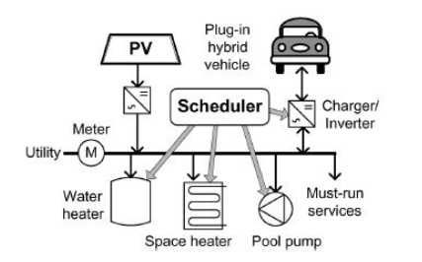
Smart Home Optimized for energy service
Smart Home designed to help householder make scheduler decisions
Core components energy service model and Distributed Energy Resource (DER) algorithm
Describes energy service demon
i.e. hourly hot water consumption
Hot water consumption = Used energy = energy equivalent of water service
Goal: increase monetary benefit from every energy equivalent unit
Scheduler used to adjust energy consumption
Optimized problem
monetary benefit signed to energy equivalent unit
energy demand
X applied scheduler algorithm

Slide 5
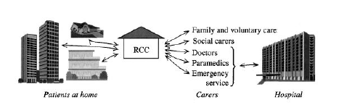
Smart Health Home
Smart Home takes care of its householder
RCC = remote control center
Intelligent house
Tele medical system
Tele consulting
Tele diagnosis
Real-time imaging
Distance medical education
Communication technologies

Slide 6
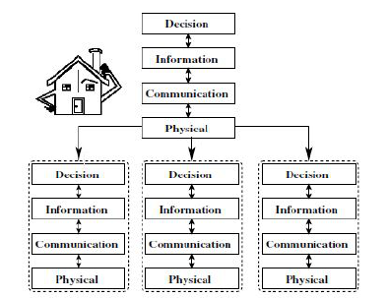
Smart Agent Home
MavHome - Managing an intelligent versatile home
4 layers based agents
Core feature: householder behavior prediction
Objective - Archive comfortable living conditions
Agents
Observer and learn user’s behavior
Make decisions and of course mistakes
Learn from wrong , inappropriate decisions and then self adjust
Machine learning, AI technology, mobile computing, robotics
Prediction algorithm
SHIP
ALZ
Task-based Marko model

Slide 7
OPC UA applications
OPC UA and ICS
Industrial control system
Present-day’s ICS neglects secure issues
OPC UA provides well-defined, robust and reliable security model
Clear and defined objectives in each communication stack layer
SOAP + WS security
HTTP + SSL
Authentication
PWD
X.509 certificates

Slide 8
OPC UA applications
OPC UA and Smart Grid
Smart Grid
The future of electricity industry
Intelligent electricity distribution
Customer and supplier coordination
OPC UA is the best candidate
Secure model
Real time communication and traceability
OPC UA Event and alarm model
OPC UA Data Access model
OPC UA Historical Data Access model

Slide 9
OPC UA applications
Nano OPC UA
Newly released by Lemgo
OPC UA can be deployed in enterprise level ERP system and downscaled to low level device with limited resource
Chip embedded OPC UA server
Provide full core server services
TCP binary communication

Slide 10
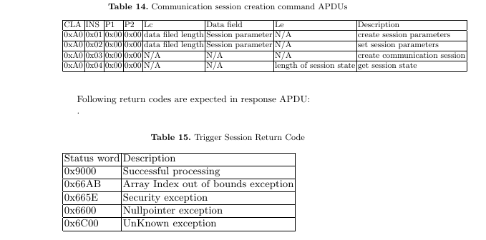
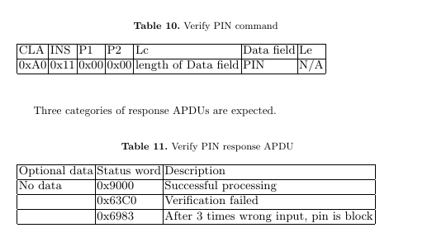
Extra Design presentation - API

Slide 11
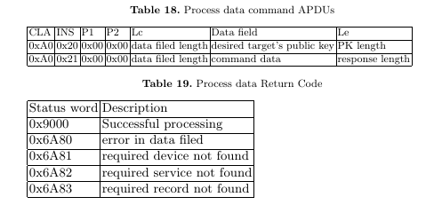
Extra Design presentation - API
Command data could be various… so TLV formatted cmd data is introduced
A0210000129010910892069C0401020304
Read current value from Sener,
whose id = 0x01 0x02 0x03 0x04
HOW?

Slide 12
Command TLV
Tag | Length | Name |  |  |  |  |  |  |  |  | Presence
‘90’ | 0-n | Command sent to home device |  |  |  |  |  |  |  |  | optional
 |  | Tag | Length | Name
 |  | ’91’ | 0-n | Parameters
 |  |  |  | Tag | Length | Name
 |  |  |  | ‘92’ | 1-n | Read sensor value
 |  |  |  |  |  | Tag |  | Length |  | Name
 |  |  |  |  |  | ‘9C’ |  | 1-n |  | Sensor id
 |  |  |  | ‘93’ | 1-n | Set subscription
 |  |  |  |  | 1-n | Tag |  | Length |  | Name
 |  |  |  |  |  | ‘9A’ |  | 1-n |  | Sub value
 |  |  |  | ‘94’ | 1-n | Get historical record
 |  |  |  |  |  | Tag |  | Length |  | Name
 |  |  |  |  |  | ‘9D’ |  | 1-n |  | Device id
 |  |  |  | ‘95’ | 1 | Open main door
 |  |  |  | ‘96’ | 1 | Café maker add water
 |  |  |  | ‘97’ | 1 | Café maker add cafe
 |  |  |  | ‘98’ | 1 | Café maker make cafe
 |  |  |  | ‘99’ | 1-n | Grant main door access to
 |  |  |  |  |  | Tag | Length |  | Name
 |  |  |  |  |  | ‘9B’ | 1-n |  | User id

Slide 13


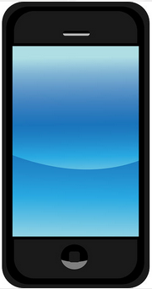
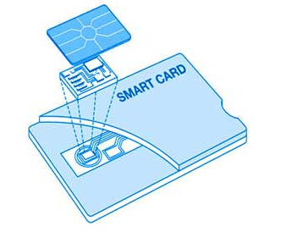
Scenario Explanation
Case-1
Case-2
OTA and PKI
Notes:
http://www.google.de/imgres?imgurl=http%3A%2F%2Fwww.andreonicards.com%2Fimages%2Fcontactsmartcard1.jpg&imgrefurl=http%3A%2F%2Fwww.andreonicards.com%2Fcontactcards.htm&h=293&w=350&tbnid=x2BNI6hifzNcEM%3A&zoom=1&docid=eYurWjaqIAPFeM&hl=zh-CN&ei=Tpf5U5OrJMT17AbZ8oHQDA&tbm=isch&iact=rc&uact=3&dur=774&page=1&start=0&ndsp=46&ved=0CCgQrQMwAA
http://www.google.de/imgres?imgurl=http%3A%2F%2Fsawvideo.com%2Fsites%2Fsawvideo%2Ffiles%2Fuploads%2Fsmartphone.jpg&imgrefurl=http%3A%2F%2Fsawvideo.com%2Fresources%2Fworkshop%2Fscheduled%2Fexperimental-smartphone-video-0&h=640&w=640&tbnid=X-INBfXVBeyj3M%3A&zoom=1&docid=dNUx6CIGPI5atM&hl=zh-CN&ei=vZf5U919qaniBPqmgcgL&tbm=isch&iact=rc&uact=3&dur=3756&page=1&start=0&ndsp=44&ved=0CEgQrQMwCg

Slide 14
Demo Case 1
Participant
UICC card
Appelt
Jacade
Universal Test Environment provided by Morphe
TC1 Open Channel Triggered by SMS
TC2 Exchange R-APDU and C-APDU
TC3 Close Channel
Morpho SC5-01OS07 LTE Product
Theoretical support
GP RAM over HTTP
TLS 1.2
Public key infrastructure

Slide 15
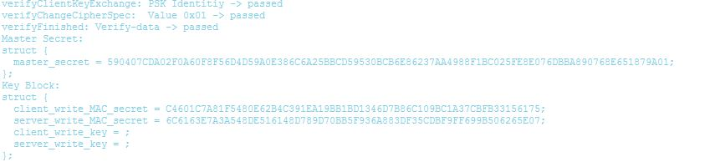
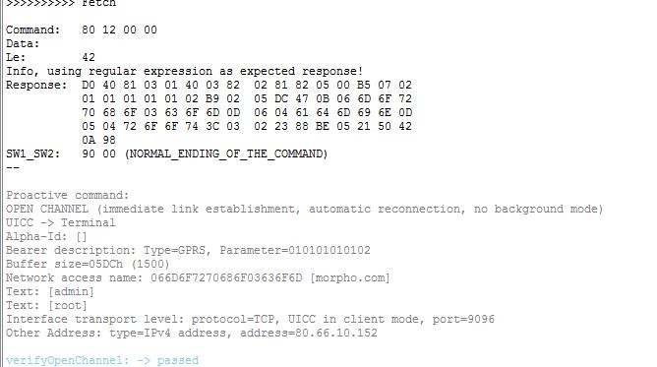
Demo Case 1

Slide 16
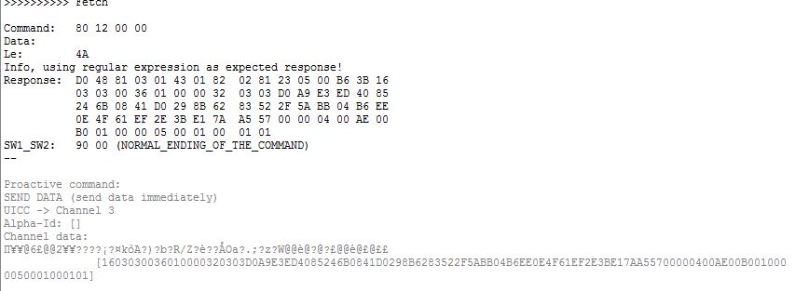
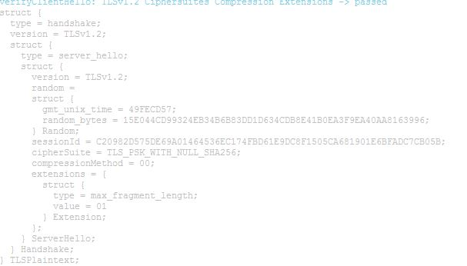
Demo Case 1

Slide 17
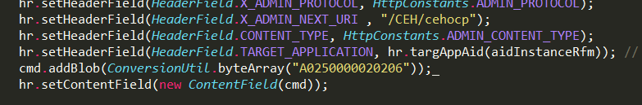


Demo Case 1
CLA A0
INS 25
LC 02
DATA 0x20 0x26

Slide 18
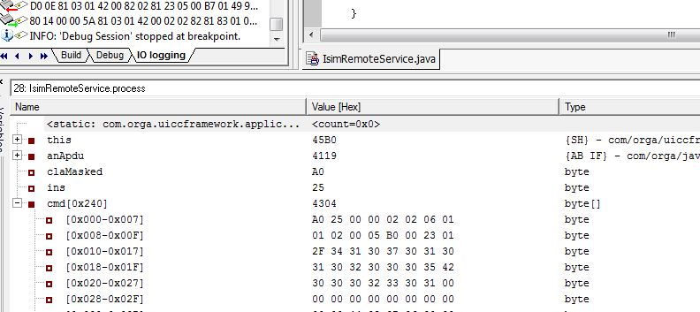
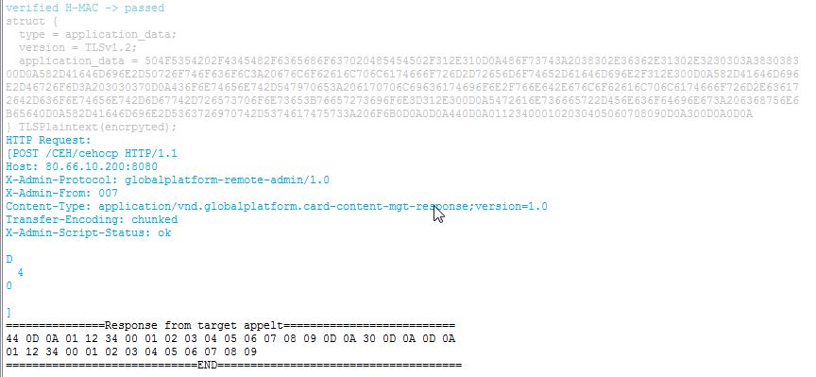
Demo Case 1

Slide 19
Demo Case 2
Participant
UICC card
Smart Home Applet
Android APP
Jacade and Eclipse IDE with Android Development Tools
Morpho SC5-01OS07 LTE Product
Web Sever
Apache 2.4.9
PHP 5.5.12
MySQL
Theoretical support
OpenMobileAPI
GP Secure Element access control

Slide 20
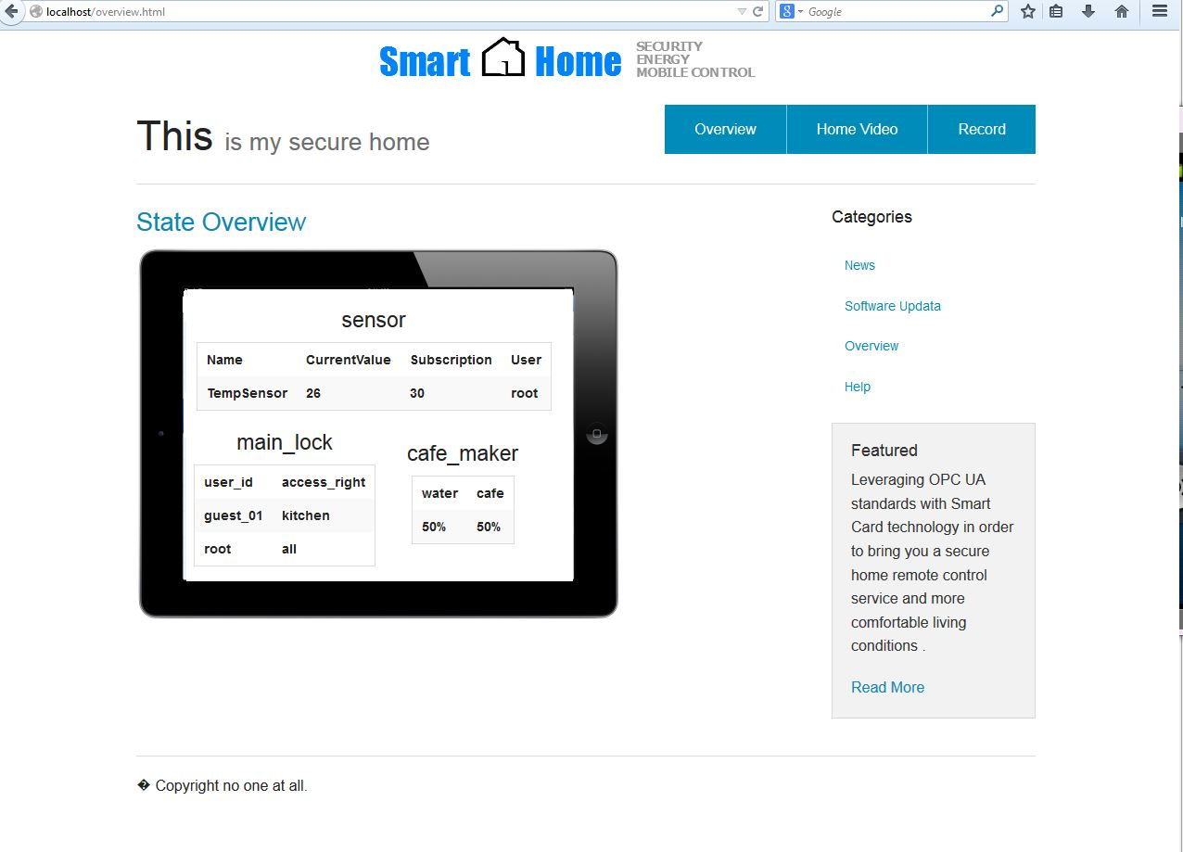
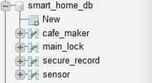
Demo Case 2

Slide 21
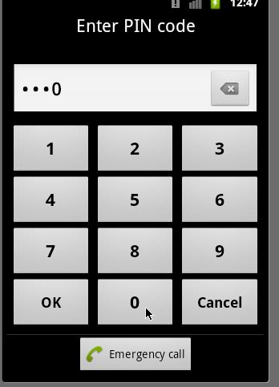
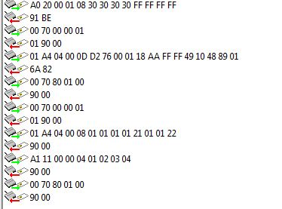
Demo Case 2

Slide 22
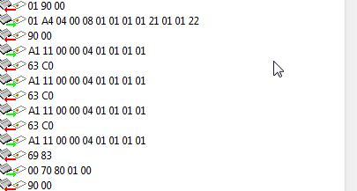
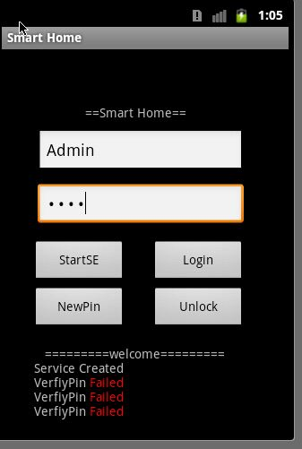
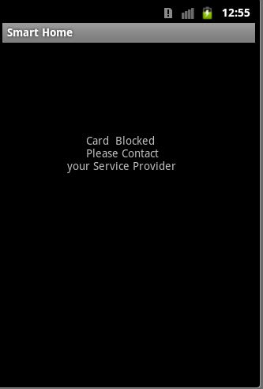

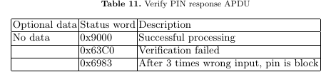
Demo Case 2

Slide 23
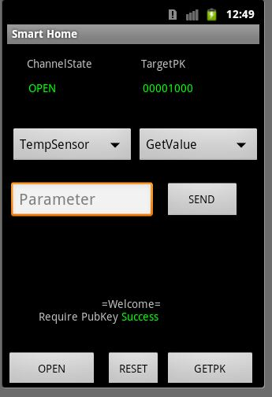
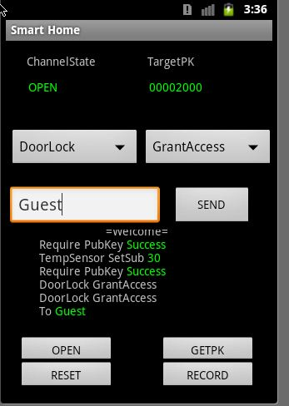
Demo Case 2

Slide 24
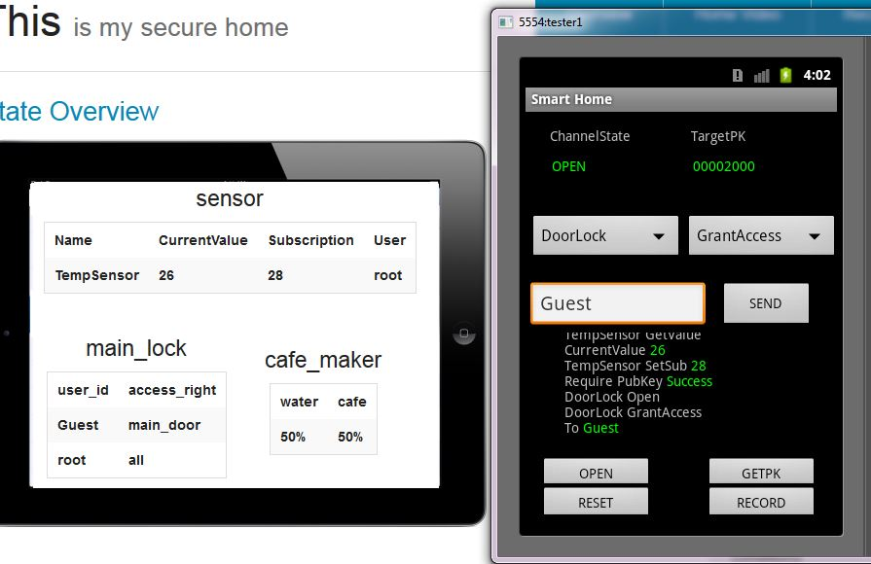
Demo Case 2

Slide 25
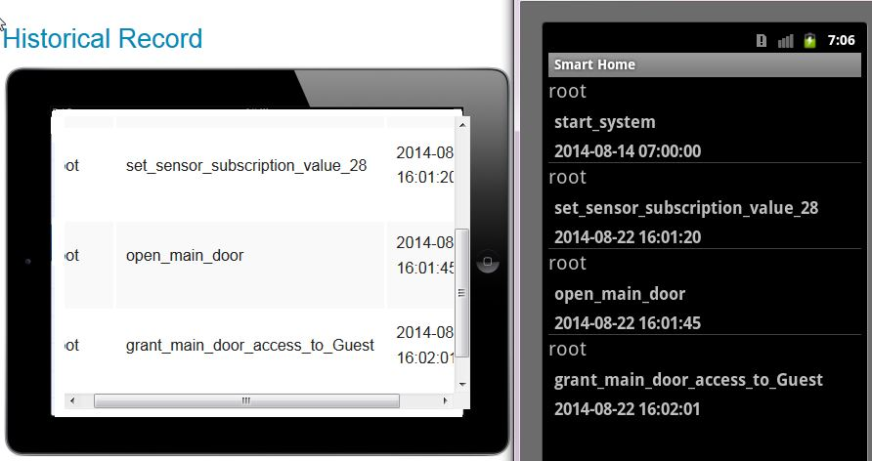
Demo Case 2

Slide 26
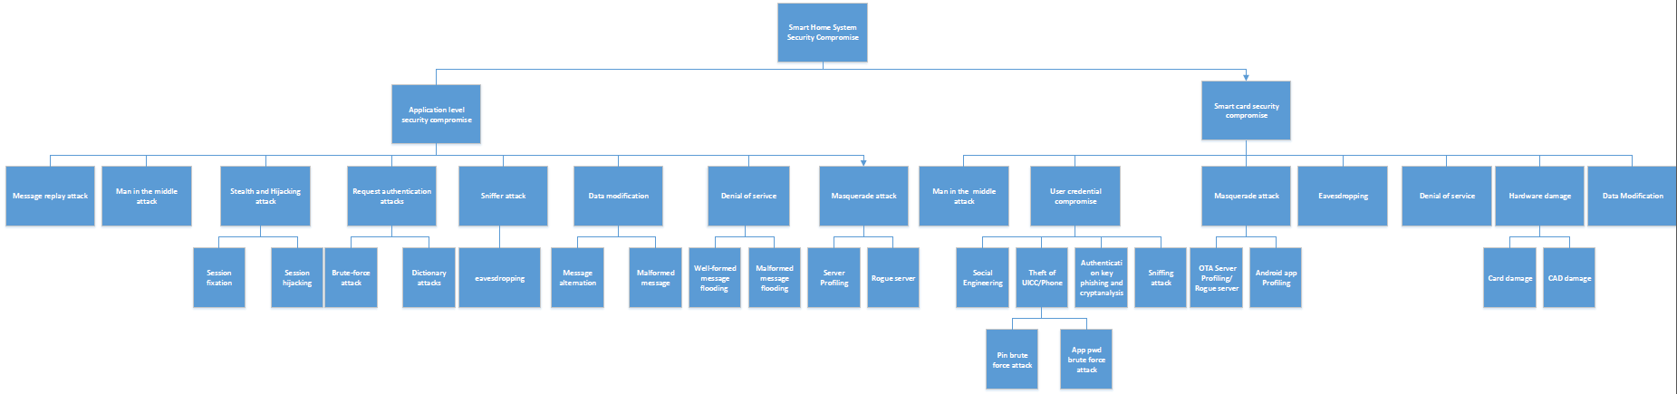
Attack tree overview

Slide 27
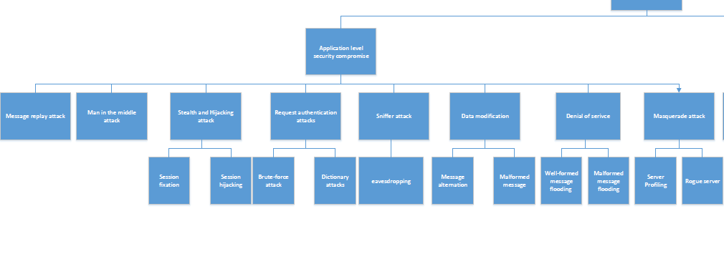
Attack tree overview

Slide 28
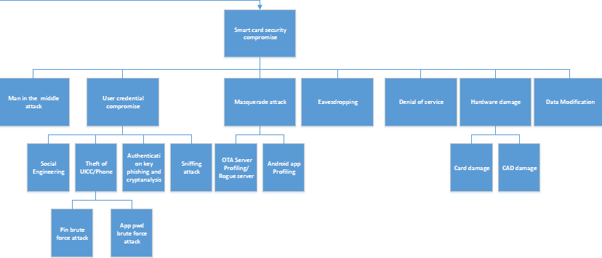
Attack tree overview

Slide 29
Secure Analyses
Application level security compromise
Message replay attack
Man in the middle attack
Stealth and Hijacking attack
Session fixation
Session hijacking
Request authentication attack
Brute-force attack
Dictionary attack
Sniffer attack
eavesdropping
Session id,
Channel id. Seqencue Num
Try Limit
Communication rate control
TLS 1.2 cipher suits

Slide 30
Secure Analyses
Application level security compromise
Data modification
Message alternation
Malformed message
Denial of service
Well-formed message flooding
Malformed message flooding
Masquerade attack
Server profiling
Rogue server
Check sum/signature
Structure parser
Communication rate control
TLV command parser
TLS handshake
PKI

Slide 31
Secure Analyses
Smart card security compromise
User Credential Compromise
Theft of UICC/Phone
PIN Brute force attack
APP PWD Brute force attack
Sniffing attack
Social engineering
Authentication key phishing and cryptanalysis
Man in the middle attack
Denial of service (OTA server)
Masquerade attack
App profiling
Malicious user
Server profiling
Try counter
Block phone
PKI guarantee
TLS 1.2
PKI
SE access control
Openmobile Api

Slide 32
Secure Analyses
Smart Home System Secure Compromise
Data Modification
Eavesdropping
Hardware damage
Card damage
CAD damage
Applet firewall

Slide 33
Thank you! Question?

